Slide 1

TRAVEL AND TOURISM
Name Roll_Number
Konduri Shivani 2110030284
Nouluri Rajashri 2110030283
Sudarshan sastry 2110040032
Pilli Vaishnavi 2110030054
Manisri 2110030203

Slide 2
Problem Statement
Are you wondering how we can solve the challenge of adventurers struggling to find and explore hidden natural wonders due to a lack of accessible information and comprehensive guides?

Slide 3
Introduction
Adventure tourism is a popular and exciting segment of the travel and tourism industry.
It involves travelers engaging in adventurous activities and exploring remote, exotic, and possibly hostile areas outside their comfort zone
It also gives the opportunity for people to understand the culture, civilization, and religious aspects of a country.
Tourism, the act and process of spending time away from home in pursuit of recreation, relaxation, and pleasure, while making use of the commercial provision of services.

Slide 4
Solution Breakdown
We will conduct proper survey and use different resources and analyse from this to suggest the paths they want to travel .
Use local websites. ...
Search using Google Maps. ...
Check Pinterest. ...
Eavesdrop. ...
Join an existing nature-type group. ...
Use All-Trails or something similar. ...
Find some local books about your area. ...
Cross-reference it all with Instagram.

Slide 5
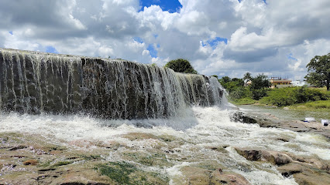
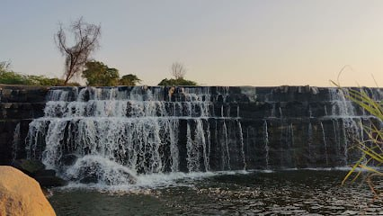
Hidden Gems in City
Nanajipur Waterfalls
Rajendra Nagar waterfalls

Slide 6
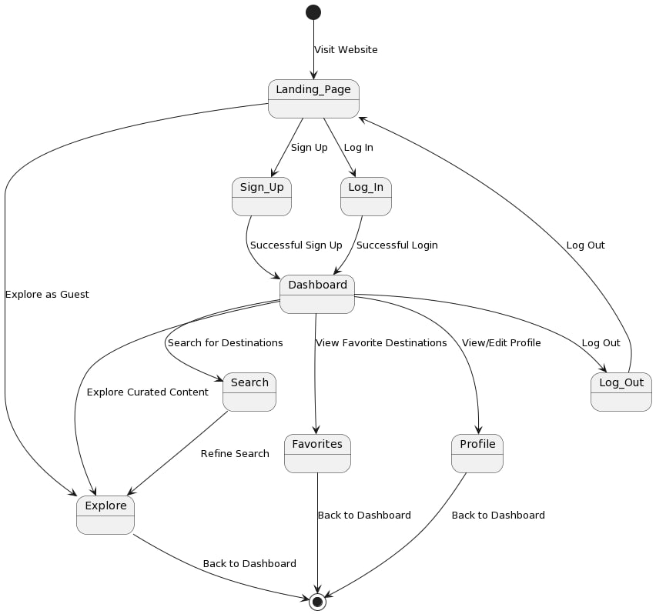
Implementation

Slide 7
Conclusion
We're planning to create a website where travelers can find and explore hidden gems.
These are special, lesser-known places that aren't often visited by tourists. Our website will make it easy for travelers to discover these hidden gems and plan their trips there.
It's all about helping people find unique and interesting places to visit that they might not have heard about otherwise.

Slide 8


